Slide 1
Economics Course Code: CSER-1209
Md. Rabiul Karim
Assistant Professor
Department of Economics
Jagannath University, Dhaka
Email: rabiulkarimjnu@gmail.com

Slide 2
Definition of Economics
The study of how society chooses to allocate its scarce resources to the production of goods and services in order to satisfy unlimited wants.
Economics is the study of how people and society choose to employ scarce productive resources to produce goods and services and distribute them among various groups of society
Economics
Microeconomics
Macroeconomics

Slide 3
Microeconomics vs. Macroeconomics
Microeconomics
Macroeconomics
The branch of economics that studies decision-making by a single individual, household, firm, industry, or level of government.
The branch of economics that studies decision-making for the economy as a whole.

Slide 4




























































Microeconomics vs. Macroeconomics
Examples of microeconomic and macroeconomic concerns
 | Production | Prices | Income | Employment
Microeconomics | Production/Output in Individual Industries and Businesses How much steel How many offices How many cars | Price of Individual Goods and Services Price of medical care Price of gasoline Food prices Apartment rents | Distribution of Income and Wealth Wages in the auto industry Minimum wages Executive salaries Poverty | Employment by Individual Businesses & Industries Jobs in the steel industry Number of employees in a firm
Macroeconomics | National Production/Output | Aggregate Price Level | National Income Total wages and salaries | Employment and Unemployment in the Economy
 | Total Industrial Output Gross Domestic Product Growth of Output | Consumer prices Producer Prices Rate of Inflation | Total corporate profits | Total number of jobs Unemployment rate
5/5/2012
Arihant Jain P.G.D.M.
17

Slide 5
Scope of Economics
Microeconomics studies
Buying decisions of the individual
Consumers’ satisfaction
Buying and selling decisions of the firm
The determination of prices and in markets
The quantity, quality and variety of products
Profits
Macroeconomics studies
Economic growth
Unemployment and inflation
Aggregate demand and aggregate supply
Economic policies – fiscal and monetary
International trade – exports and imports
Money supply

Slide 6
Some Basic Concepts
Commodity: is a raw material used in the production process to manufacture finished goods.
Product : is a finished good sold to consumers.
Needs: are things, such as food, clothing, and shelter, that are necessary for survival. Stuffs- have to survive, generally: Food, shelter, clothing
Wants: are desires that can be satisfied by consuming a good or service. Stuff- would really like to have (Luxurious goods- TV, Fancy Food)
Utility :is a term in economics that refers to the total satisfaction received from consuming a good or service.
Consumption: the use of goods and services by households

Slide 7
Factors of Production
Land: Source of all materials and food in whatever from, in or above the earth
Labor: Human effort: the available physical and mental talents of the people who have to produce the goods and services
Capital: Tangible physical good that a person creates in the expectation that it’s use will increase future production
Organization: Institutions

Slide 8
Definition of Demand
The power to purchase a good along with willingness to purchase it
The quantity of a good that potential purchasers would buy or attempt to buy, at a certain price
“Demand is the representation of the various amounts of a product that consumers are willing and able to purchase at each of a series of possible prices during a specific period of time”

Slide 9
Law of Demand
All other things remaining unchanged, the quantity demanded of a good increases when its price decreases and vice versa.
When the price of a commodity is raised, other things remain constant, buyer tend to buy less of the commodity and vice versa.

Slide 10
Demand Schedule and Demand Curve
Demand Schedule:
-A list showing the quantity of a good that consumers would choose to purchase at different prices, with all other variables held constant
Demand Curve:
-graphically shows the relationship between the price of a good and the quantity demanded (Demand Schedule), holding constant all other variables that influence demand

Slide 11
Demand Schedule
Demand Schedule shows the different quantities of goods that a consumer is willing to buy at various prices.
Prices and quantities normally move in opposite directions
Prices | Quantity
1 | 20
2 | 15
3 | 12
4 | 10
5 | 9

Slide 12
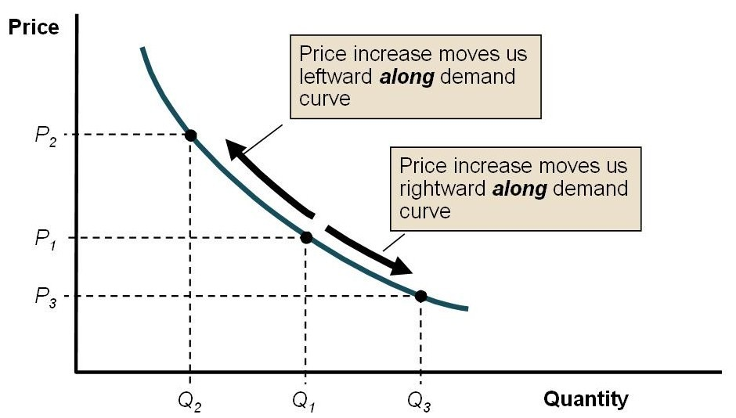

Slide 13
Demand Curve : A curve showing the relationship between the price of a good and the quantity demanded.
price
quantity

Slide 14
Why is demand curve downward Sloping?
Income effect: Changes in the quantity demanded of a commodity because the change in its price has the effect of changing a consumer’s real income.
Substitution effect: The tendency of consumers is to consume more of a good when its relative price falls and to consume less of the good when its relative price increases.

Slide 15
Demand Function:
A demand function is a causal relationship between a dependent variable (i.e., quantity demanded) and various independent variables (i.e., factors which are believed to influence quantity demanded)
Q = f(P)
Where Q= quantity and P = price of a good.
Example: Q= a – bP
Q = 20 – 4P

Slide 16
Determinants of Demand
Own Price
Income of the consumer
Price of other goods- 1. complements
2. substitutes
Tastes and preferences
Expectations of future prices
Advertising
Distribution of income

Slide 17
Shift of the Demand Curve
A change in demand is reflected by shift of the Demand curve and is caused by a change in any of the non price determinants of demand
price
Here, the curve shifts due to an increase in income or an increase in price of a substitute good etc
qty

Slide 18
Movements of the Demand Curve
A change in quantity demanded is however reflected in a movement along the demand curve and is called an extension or contraction in demand.
The movement from A to B is due to the change in price of the good all other factors remaining unchanged

Slide 19
Market Demand
The Market Demand curve is found by adding together the quantities demanded by all individuals at each price.

Slide 20


Market Demand Schedule
Price in (tk)
Units of Commodity X
Market
demanded per day
Demand
by Individuals
A B
or Total
C
1 1
2 3
4
3
5
3
5
10
2
3 5
5 9
7
15
1
10
24

Slide 21
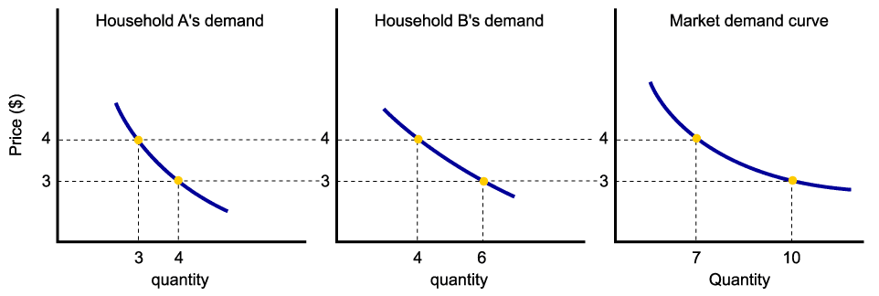
Market Demand Curve/ Aggregate Demand Curve
Assuming there are only two households in the market, market demand is derived as follows:

Slide 22
Elasticity Of Demand
Two Variables are considered while measuring the elasticity of demand :-
Demand
Determinants Of Demand
Elasticity Of Demand = percentage change in quantity demanded
percentage change in determinants of demand

Slide 23
Price Elasticity Of Demand
The price elasticity of Demand may be defined as the ratio of the relative change in demand and price variables.
e = percentage change in quantity demanded
percentage change in price

Slide 24
Five Forms of Price Elasticity of Demand
Relatively Elastic Demand
Relatively Inelastic Demand
Perfect Elastic Demand
Perfect Inelastic Demand
Unitary Elastic

Slide 25
Relatively Elastic Demand
y
When the proportionate change in demand is more than the proportionate changes in price, it is known as relatively elastic demand.
e > 1
P
R
I
C
E
Relatively elastic demand curve
D
D
0
demand
x

Slide 26
Relatively Inelastic Demand
Y
When the proportionate change in demand is less than the proportionate changes in price, it is known as relatively inelastic demand.
e < 1
D
Relatively inelastic demand curve
P
R
I
C
E
D
O
X
demand

Slide 27
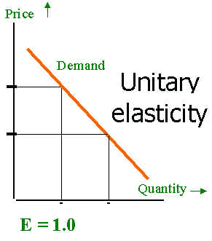
Unitary Elastic
When the proportion of change in demand is exactly the same as the change in price, the demand is said to be Unitary Elastic
e = 1

Slide 28
Perfectly Elastic
When the demand for a product changes –increases or decreases even when there is no change in price, it is known as perfect elastic demand

Slide 29
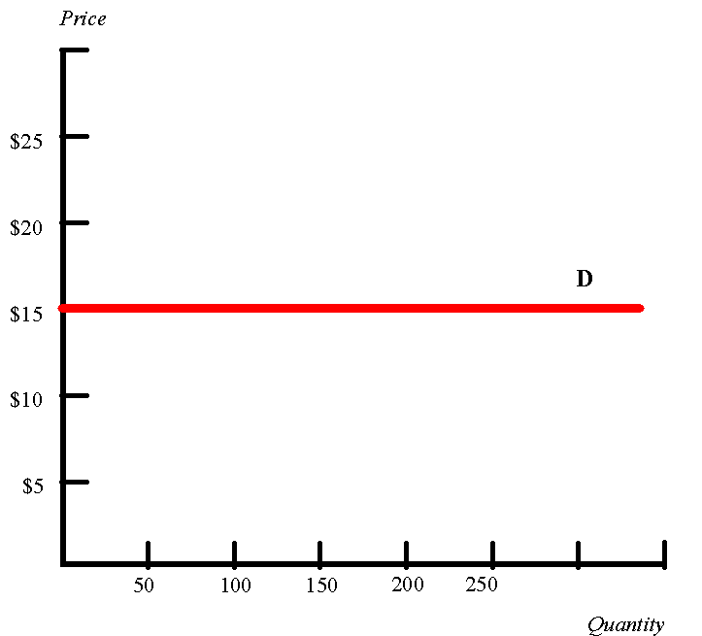
Perfectly Elastic
Consumers have indefinite demand at a particular price and none at all at an even slightly higher than this given price, demand is Perfectly Elastic
e = ∞

Slide 30
Perfectly Inelastic
When the price for a product changes –increases or decreases even when there is no change in demand, it is known as perfect inelastic demand

Slide 31
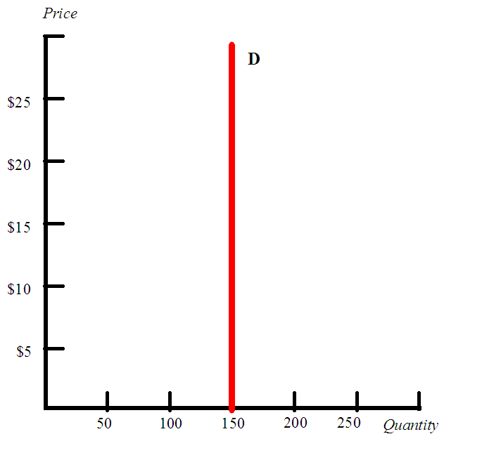
Perfectly Inelastic
When the demand for a commodity shows no response to a change in price/ whatever change in price, the demand remains same, it is called Perfectly Elastic
e = 0

Slide 32

Elasticity Of Demand
Formula
e > 1 = Relatively Elastic Demand
e < 1 = Relatively Inelastic Demand
e = 1 = Unitary Elastic

Slide 33
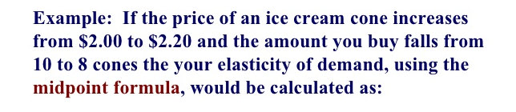
Related Mathematics

Slide 34
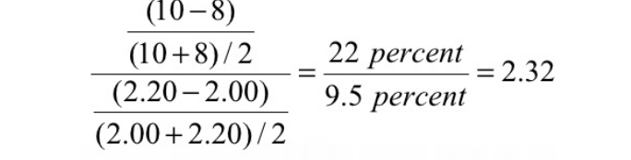

Slide 35

Trial Quiz Session

Slide 36
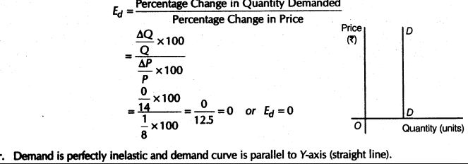
Trial Quiz Session

Slide 37

Income Elasticity Of Demand
measures the relationship between a change in quantity demanded for good X and a change in real income
The formula for calculating income elasticity is:
% Change in demand divided by the % change in income
Proportionate change in Demand
Income Elasticity Of Demand =
Proportionate change in Income
i.e.
Income Elasticity Of Demand =
∆q ∆ y
÷
Q Y

Slide 38
Supply
The quantity supplied is the number of units that sellers want to sell over a specified period of time at a particular price.
Law of Supply states that all other factors remaining unchanged the supply of a good increases as its price increases. This can be shown by a supply schedule, a supply curve or a supply function.

Slide 39
Supply Schedule and Supply Curve
Supply Schedule:
- A list showing the amount of a product that producers would produce and sell at a series of varying prices, during a certain time, with all the other factors held constant
Supply Curve:
-The graphical representation of the relation between the quantity supplied of a good that producers are willing and able to sell and the price of the good

Slide 40
Supply schedule
There exists a positive relation between quantity and price
price | quantity
1 | 2
2 | 7
3 | 12
4 | 16
5 | 18

Slide 41
Supply Curve:
price
qty
Supply function shows the relation between quantity and price.
It is a positive relation.
Example : Q= 4+3P

Slide 42
Determinants Of Supply
Price
Cost of production
Technological progress
Prices of related outputs
Govt. policy
All factors other than price cause a shift of the supply curve and is called a change in supply

Slide 43
Equilibrium Analysis
The equilibrium of supply and demand in a competitive market occurs when the forces of supply and demand are in balance
The equilibrium price is the price at which the quantity demanded just equals the quantity supplied.
Graphically, we fine the equilibrium at the intersection of the supply and demand curves

Slide 44
Equilibrium
Equilibrium - perfect balance in supply and demand
Determines market output and price
p
s
eqm
dem
p
q

Slide 45
Equilibrium in a Market
Demand | Price | Supply
20 | 1 | 1
15 | 2 | 7
12 | 3 | 12
10 | 4 | 16
9 | 5 | 18

Slide 46
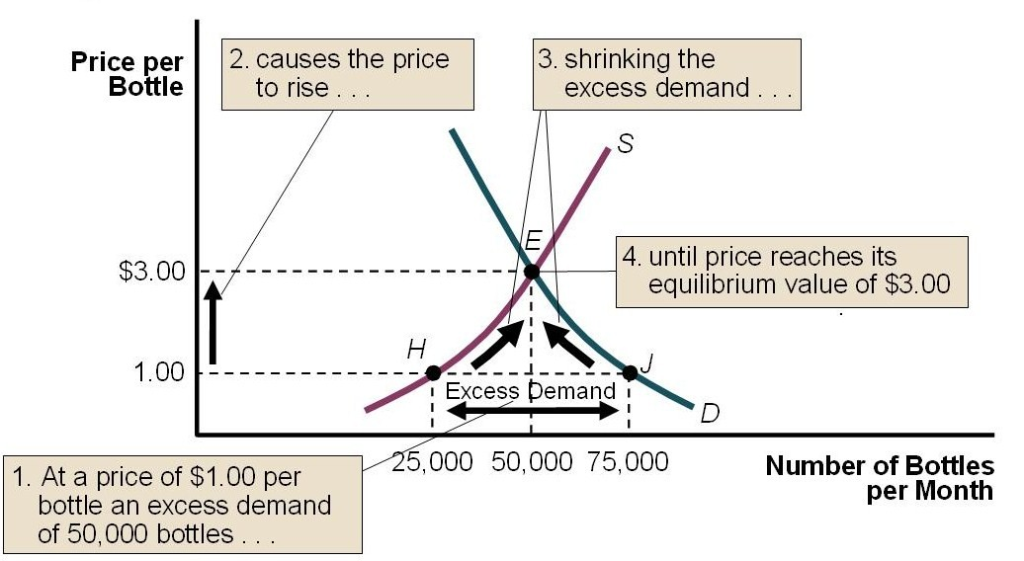

Slide 47
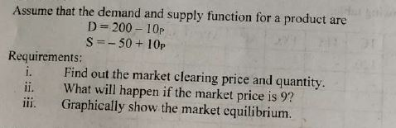
Problem 1

Slide 48
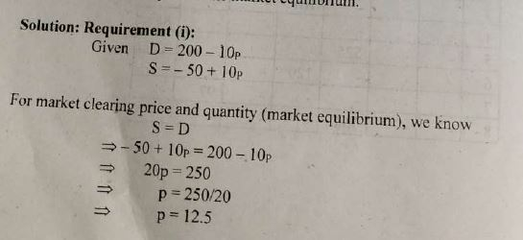

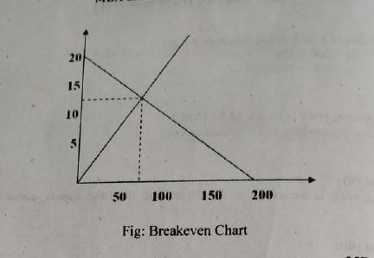
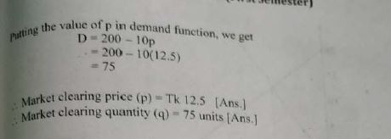
Solution 1

Slide 49
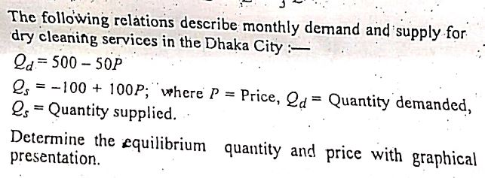
Problem 7

Slide 50
Thank You!

